Slide 1

Problem solving using iteration and recursion with examples such as Fibonacci numbers and Hanoi towers
Data Structure | ADT: Stack and Queue
Course: Data Structure | Chapter: ADT: Stack and Queue | Bachelor of Engineering
DISCOVER · LEARN · EMPOWER
Notes:
Welcome students to today's lecture on Data Structures. We will focus specifically on how to solve problems using iteration and recursion. Our primary examples will be the Fibonacci sequence and the Tower of Hanoi puzzle. These concepts are fundamental to understanding how stacks and queues operate in real-world scenarios.

Slide 2
Course Outcomes
SLIDE 2 / 10
Course Outcome
CO | BT LEVEL | DESCRIPTION
CO1 | BT1 | Understand and apply basic data structures, algorithms, complexity analysis, ADTs, arrays and linked lists.
CO2 | BT2 | Apply and implement stacks and queues in problem-solving.
CO3 | BT3 | Analyse and apply searching, sorting, and hashing techniques.
CO4 | BT4 | Construct and apply tree structures and traversal techniques.
CO5 | BT5 | Represent and solve graph problems using DFS, BFS, and graph algorithms.
Chandigarh University
2 / 10
Notes:
Today's lecture directly addresses our Course Outcomes. CO2 requires you to apply stacks and queues to solve problems, which we will do using recursion. CO3 involves analyzing techniques, and understanding recursion helps us analyze algorithmic complexity. Please note that while we focus on recursion, these skills support broader analysis techniques.

Slide 3
Learning Objectives
SLIDE 3 / 10
Learning Outcomes
1
Define the fundamental difference between iterative and recursive problem-solving approaches.
2
Implement the Fibonacci sequence algorithm using both iteration and recursion.
3
Analyze the recursive logic required to solve the Tower of Hanoi problem.
4
Demonstrate how the call stack manages recursive function calls during execution.
5
Compare the time and space complexity of iterative versus recursive solutions.
Chandigarh University
3 / 10
Notes:
By the end of this session, you will be able to define the core differences between iteration and recursion. You will implement the Fibonacci sequence using both methods to see the performance gap. We will also analyze the Tower of Hanoi to understand how the call stack manages complex recursive logic. Finally, you will compare the efficiency of these two distinct approaches.

Slide 4
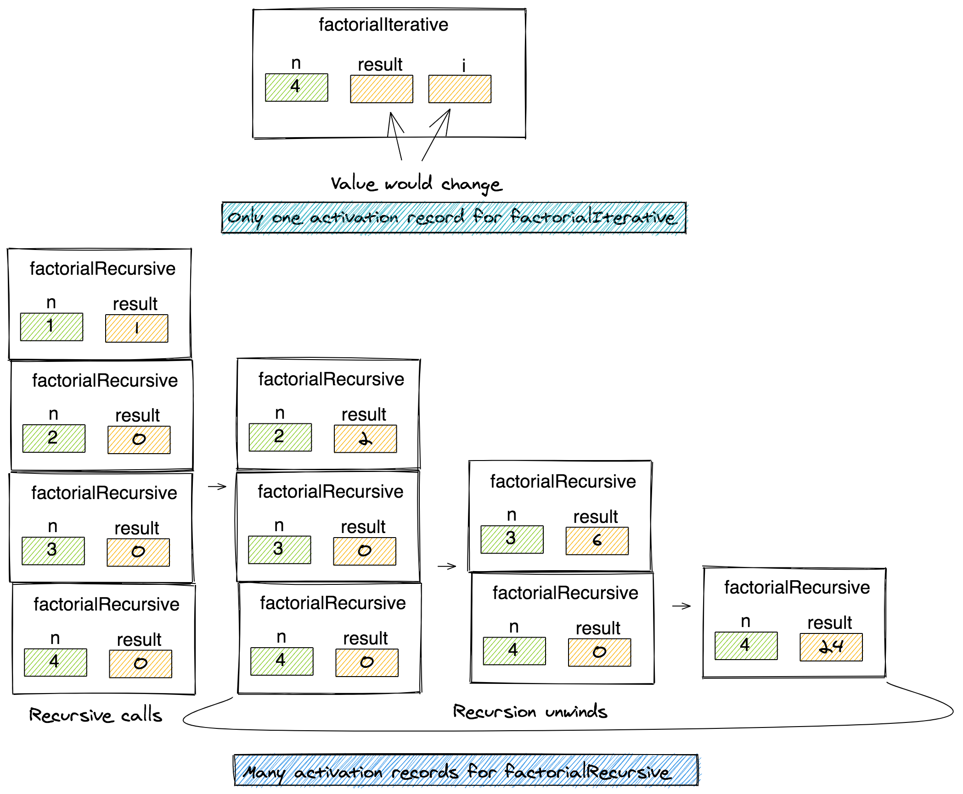
Lecture
SLIDE 4 / 10
Iteration vs Recursion Fundamentals
1
Iteration uses loops to repeat a block of code until a condition is met.
2
Recursion involves a function calling itself with modified parameters to solve smaller sub-problems.
3
Every recursive solution requires a base case to prevent infinite loops and stack overflow.
4
Iteration generally uses less memory as it does not create new stack frames for each step.
5
Recursion often provides a more elegant solution for problems with inherent self-similar structures.
AlgoDaily - Problem Solving With Recursion vs. Iteration
Chandigarh University
4 / 10
Notes:
Iteration is straightforward, using loops like for or while to repeat actions. Recursion is more complex, where a function calls itself to break a problem into smaller pieces. Crucially, every recursive function must have a base case, like n=0, to stop the calls. Without a base case, the program will crash due to a stack overflow error.

Slide 5
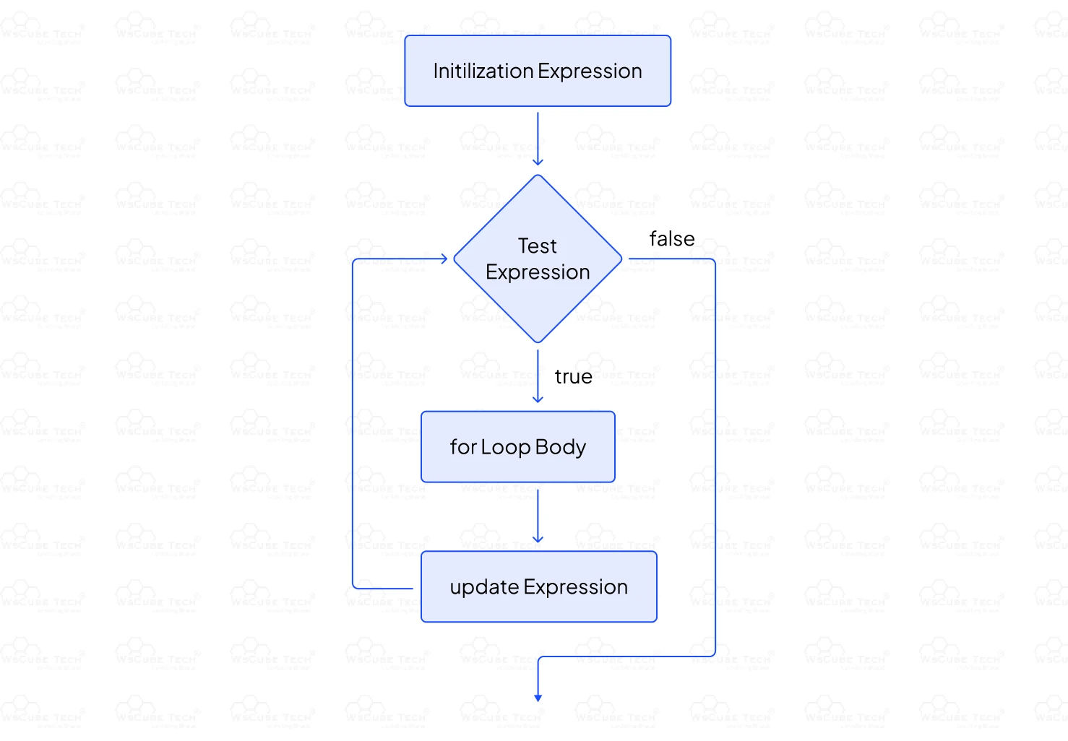
Fibonacci Sequence
SLIDE 5 / 10
Iterative Approach
1
The iterative approach calculates Fibonacci numbers using a loop and two temporary variables.
2
We initialize the first two numbers as 0 and 1 before starting the loop.
3
In each iteration, the next number is the sum of the previous two values.
4
This method updates variables in place without creating new function calls or stack frames.
5
The time complexity for this approach is O(n) with constant space O(1).
Source: deen3evddmddt.cloudfront.net
Chandigarh University
5 / 10
Notes:
Let's look at the iterative Fibonacci algorithm. We start with 0 and 1, then loop to add them. For example, to find the 5th number, we calculate 0+1=1, then 1+1=2, then 1+2=3. This method is very efficient because it only stores the last two numbers at any time. It avoids the overhead of function calls entirely.

Slide 6
Fibonacci Sequence
SLIDE 6 / 10
Recursive Approach
GOVERNING EQUATION
The base cases are F(0) = 0 and F(1) = 1, which stop the recursion
1
The recursive definition states F(n) = F(n-1) + F(n-2) for n greater than 1.
2
Each call creates a new stack frame to store local variables and return addresses.
3
This approach recalculates the same values multiple ×, leading to exponential time complexity.
4
The time complexity is O(2^n), making it inefficient for large values of n.
Chandigarh University
6 / 10
Notes:
Now consider the recursive definition where F(n) equals the sum of the two preceding numbers. To find F(5), the function calls F(4) and F(3). This creates a tree of calls where F(2) is calculated multiple ×. This redundancy makes the recursive approach significantly slower than the iterative one for larger inputs.

Slide 7
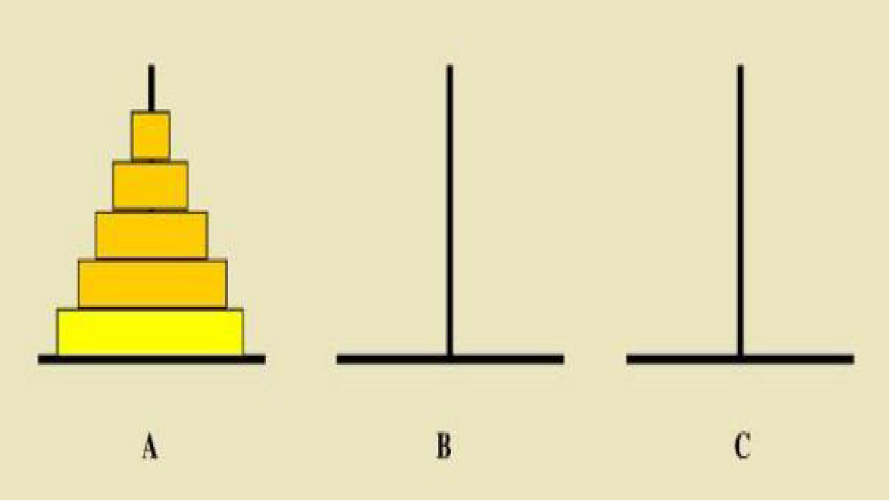
Tower of Hanoi
SLIDE 7 / 10
Problem Statement
1
The problem involves moving n disks from a source rod to a destination rod.
2
We must use an auxiliary rod while ensuring a larger disk never sits on a smaller one.
3
The recursive solution moves n-1 disks to the auxiliary rod first.
4
It then moves the largest disk directly to the destination rod.
5
Finally, it moves the n-1 disks from the auxiliary rod to the destination rod.
Source: d2vlcm61l7u1fs.cloudfront.net
Chandigarh University
7 / 10
Notes:
The Tower of Hanoi is a classic problem that demonstrates recursion perfectly. We have three rods and n disks of different sizes. The rule is simple: you cannot place a larger disk on top of a smaller one. The solution involves moving the top n-1 disks to the helper rod, moving the bottom disk, and then moving the stack again.

Slide 8
Tower of Hanoi
SLIDE 8 / 10
Recursive Logic
1
The recursive function takes parameters for the number of disks, source, auxiliary, and destination.
2
If n equals 1, we simply move the disk from source to destination directly.
3
Otherwise, we recursively move n-1 disks from source to the auxiliary rod.
4
We then move the nth disk from the source rod to the destination rod.
5
Finally, we recursively move the n-1 disks from the auxiliary rod to the destination.
Chandigarh University
8 / 10
Notes:
The logic relies on breaking the problem down. If we have 3 disks, we first move the top 2 to the helper. Then we move the largest disk to the target. Finally, we move the 2 disks from the helper to the target. This pattern repeats until we are just moving a single disk.

Slide 9
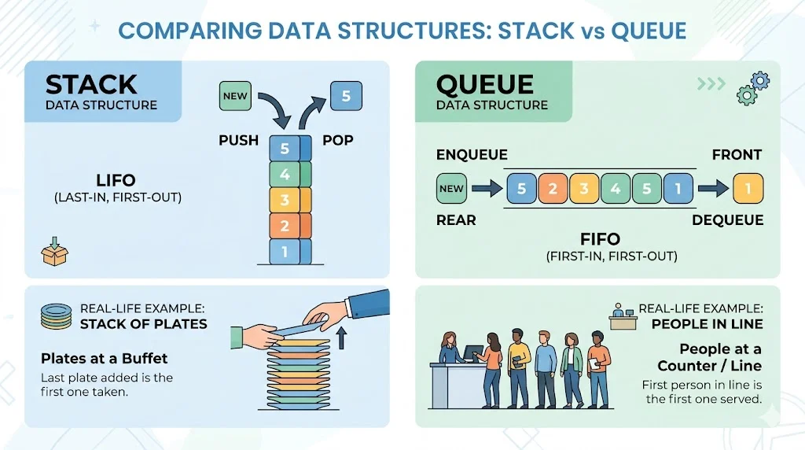
Lecture
SLIDE 9 / 10
Key Takeaways
1
Recursion solves problems by breaking them into smaller, self-similar sub-problems.
2
Iterative Fibonacci is efficient with O(n) time and O(1) space complexity.
3
Recursive Fibonacci is simple to write but inefficient with O(2^n) time complexity.
4
The Tower of Hanoi demonstrates how the call stack manages complex recursive movements.
5
Understanding the call stack is essential for debugging recursive functions in Data Structures.
Source: synonymsflow.com
Chandigarh University
9 / 10
Notes:
To summarize, recursion is powerful but requires careful management of the base case and stack depth. While recursive Fibonacci is elegant, the iterative version is far superior for performance. The Tower of Hanoi illustrates how the stack naturally handles the 'undo' process required by recursion. Always consider the trade-off between code simplicity and execution efficiency.

Slide 10
Lecture
SLIDE 10 / 10
References
DATA STRUCTURES
A Pseudocode Approach with C — Gilberg, Forouzan
• Data Structures — Lipschutz
• Data Structure Using C — AK Sharma
• C and Data structure — P. S. Deshpandey
Chandigarh University
10 / 10
Notes:
For further reading, please refer to the textbooks listed on this slide. Gilberg and Forouzan provide excellent pseudocode approaches to these algorithms. Lipschutz and Sharma offer detailed C implementations that you can use for your lab work. Deshpandey is also a great resource for understanding the underlying logic of these data structures.

